Slide 1

Chemistry: CHEM 201TH
CARBOHYDRATES
Department of Chemistry
Government College
Paonta Sahib (HP)

Slide 2
Today’s Topics
Ring Size of D-(+)-Glucose
Haworth Projection Formulae of α and β Forms of D-(+)-Glucose
Confirmation of α- and β-D-(+)-Glucopyranose

Slide 3
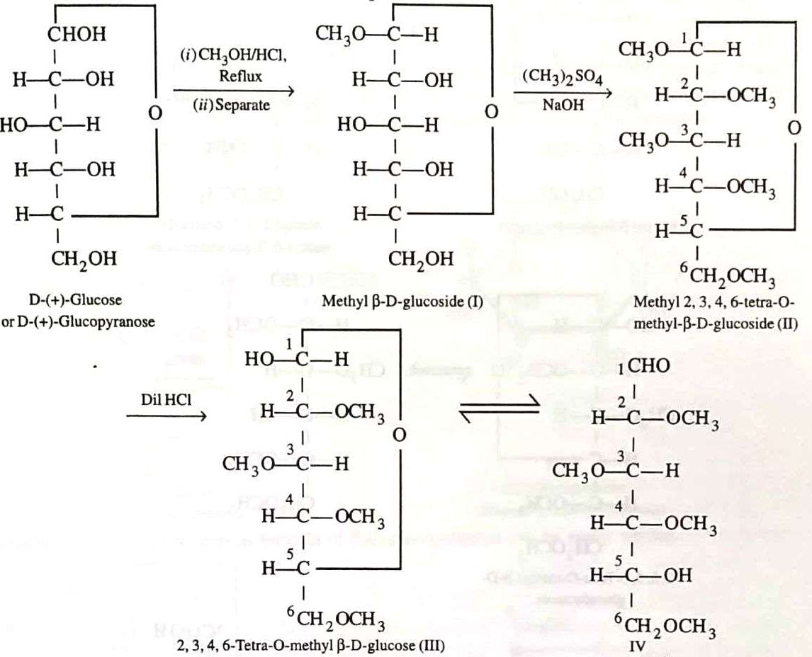
Ring Size of D-(+)-Glucose
The actual size of the ring in glucose is six-membered and not five-membered, is established by the following experiment.
D-(+)-Glucose was converted into a mixture of α- and β-D-methyl glucosides by treatment with CH₃OH and dry HCl gas and so formed β-methyl-3-D-glucoside was separated (I).
(I) was then treated with dimethyl sulphate and sodium hydroxide to form (II).
This on treatment with dil. HCI, only -OCH₃ group at C₁ was hydrolysed to form (III). This compound is a cyclic hemiacetal and hence is present in equilibrium with a small amount of the open chain form (IV) .
Continue ………

Slide 4

The open chain form (IV) contains a free -OH group, four -OCH₃ groups and one -CHO group. The -OH group must certainly be present on that carbon which was originally involved in ring formation i.e. C₄ or C₅.
To decide this, (III) was oxidised with nitric acid, then a mixture of trimethoxyglutaric acid (VI) and dimethoxysuccinic acid (VII) is obtained.
This is possible only if the oxidative cleavage of the intermediate keto acid (V) occurs on either side of C₅. This implies that in the open chain structure (IV) of tetra-O-methyl-β-D glucose, the free -OH group is present at C₅. Hence the actual size of the ring in glucose is six-membered.

Slide 5
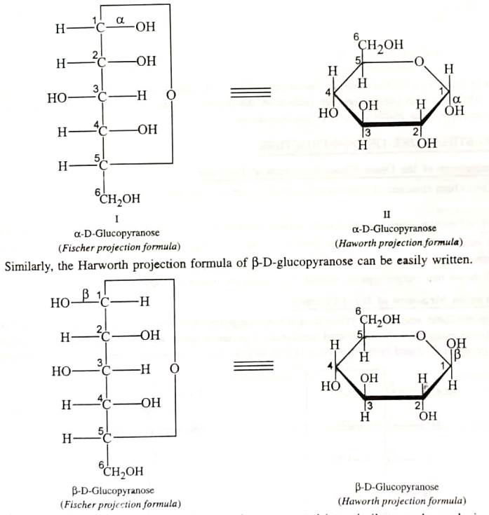
Haworth Projection Formulae of α- and β-D-(+)-Glucopyranose
For any six-membered monosaccharide, draw a hexagon (II) with its oxygen atom on the right hand side farthest from to observer.
The terminal -CH₂OH group is always placed above the plane of the hexagon ring.
All the groups, (on C₁, C₂, C₃ and C₄) present on left hand side in the plane Fischer projection formula (I) are placed above the plane of the ring.
All those groups present on the right hand side below the plane of the in.
The formula (II) thus represents the Haworth projection formula of a-D-(+)-glucopyranose
Continue ………

Slide 7
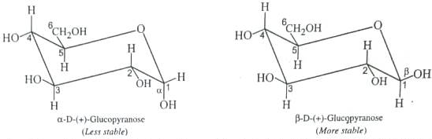
Confirmation of α- and β-D-(+)-Glucopyranose
Glucose and other carbohydrates are best represented in terms of their chair and boat forms conformations. Although glucose exists in the chair form and -OH groups at C₂, C₃ and C₄ and the CH₂OH at C₆ are all assumed to be in the more stable equatorial orientation.
But in in the α-D-(+)-glucopyranose form, the -OH group exists at axial position while in β-D-(+)-glucopyranose, -OH group exists at equatorial position.
Therefore, α-D-(+)-glucopyranose suffers with 1,3-biaxial interaction with axial hydrogens at C₃ and C₅ while no such interactions are present in the β-form. Consequently, β-D-(+)-glycopyranose is thermodynamically more stable than a-D-glucopyranose.

Slide 8
Next Lecture
Limitations of the Open Chain Structure of Fructose
Pyranose Structure of D-(-)-Fructose
Ring Size of D-(-)-Fructose
Haworth Projection Formulae

Slide 9
Thank You

